Slide 1


Implementation of Chatbot using NLP
Name: Vanshita A. Paraye
Student ID: STU678d5230d31ee1737314864
Email: vanshitaparaye22@gmail.com

Slide 2

Learning Objectives
Understanding Natural Language Processing (NLP) techniques
Developing an AI chatbot using Python and Streamlit
Implementing Machine Learning (Logistic Regression, TF-IDF) for intent recognition
Enhancing chatbot interactions for accurate and context-aware responses
Managing conversation history using CSV logging for data analysis
Debugging and optimizing chatbot responses for improved accuracy
GOAL
Source :
www.freepik.com/

Slide 3
Tools and Technology used
✅ Programming Language: Python ✅ Framework & UI: Streamlit for chatbot interface ✅ NLP Processing: NLTK for text tokenization and preprocessing ✅ Machine Learning Model: Logistic Regression for intent classification ✅ Feature Extraction: TF-IDF Vectorization for text representation ✅ Data Management: JSON for storing intents, CSV for logging chat history ✅ Key Libraries: nltk, sklearn, json, datetime, random ✅ Development Tools: Jupyter Notebook / VS Code for coding and testing

Slide 4
Methodology
1️⃣ Data Collection & Preprocessing
2️⃣ Feature Extraction
3️⃣ Model Training
4️⃣ Chatbot Implementation
5️⃣ Conversation Logging
6️⃣ Testing & Optimization

Slide 5
Problem Statement:
Accessing reliable healthcare information quickly can be challenging, leading to delays and misinformation. Traditional healthcare services often have long wait times and limited availability. To address this, an AI-powered chatbot is developed using NLP and Machine Learning to provide instant, accurate, and automated responses to user queries. This chatbot enhances accessibility, reduces dependency on human intervention for basic medical guidance, and improves user experience through a conversational interface.

Slide 6
Solution:
The AI Healthcare Chatbot leverages Natural Language Processing (NLP) and Machine Learning (ML) to provide instant and accurate responses to health-related queries. By utilizing TF-IDF Vectorization and Logistic Regression, it efficiently classifies user inputs and generates relevant replies. The chatbot is built with Streamlit, offering a simple and interactive interface for seamless communication. Additionally, it logs conversations in a CSV file for future analysis and improvements. This solution ensures 24/7 accessibility, reduces misinformation, and enhances user engagement by providing quick medical assistance.

Slide 7
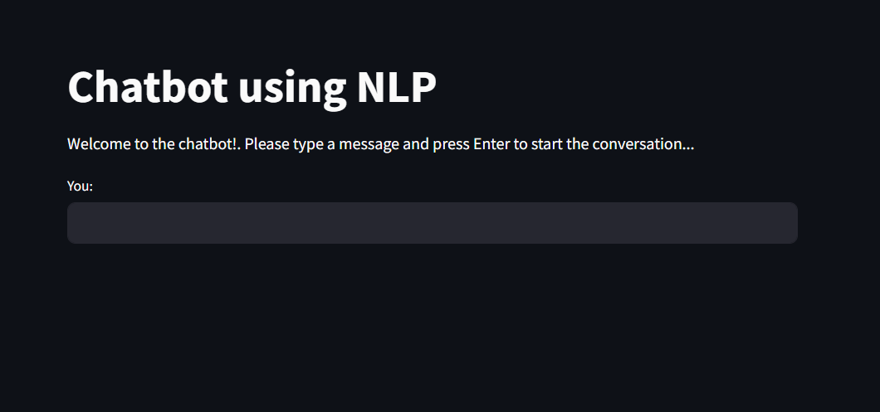
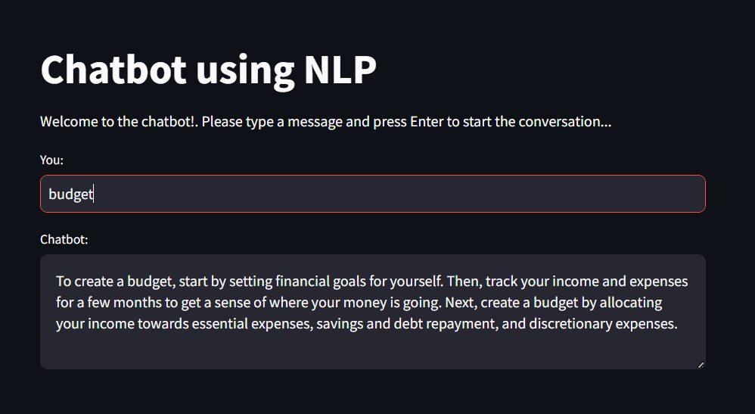
Screenshot of Output:

Slide 8
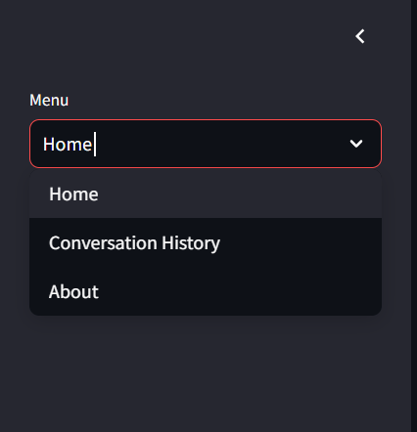
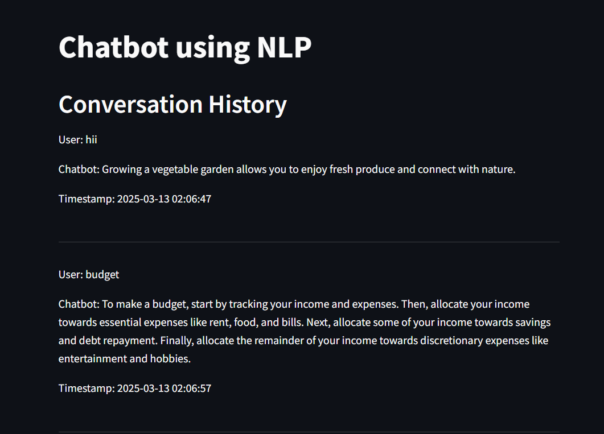
Screenshot of Output:

Slide 9
Conclusion:
The AI Healthcare Chatbot successfully provides quick, reliable, and automated responses to user queries using NLP and Machine Learning. By integrating Logistic Regression for intent classification and Streamlit for a user-friendly interface, it ensures a smooth and interactive experience. The chatbot enhances healthcare accessibility, minimizes misinformation, and offers round-the-clock assistance. Future enhancements could include expanding the dataset, integrating real-time medical databases, and adding voice-based interactions for an even better user experience.
GitHub Link 👉
https://github.com/vanshita-ai/nlp-chatbot.git

